Slide 1
CSE425 Presentation
Custom Convolutional Neural Network Implementation and Comparative Analysis
Name: Muhammad Nayeem Mubasshirul Haque
ID:19101115
Section: 03

Slide 2
Introduction
Choosing the dataset
Primary objectives of implementation
Performance characteristics

Slide 3
Dataset
CIFAR-10 Dataset (60,000 vibrant 32x32 color images)
Pre-processing and model readiness
Diverse object categories (10 specific categories featuring various objects)

Slide 4
Model architecture
TensorFlow and Keras libraries
Sequential convolutional and pooling layers
Fully connected layers and softmax output layer

Slide 5
Implementing traditional CNN
Emphasis on convolutional and pooling layers
Model configuration
Results (Training accuracy and validation accuracy)

Slide 6
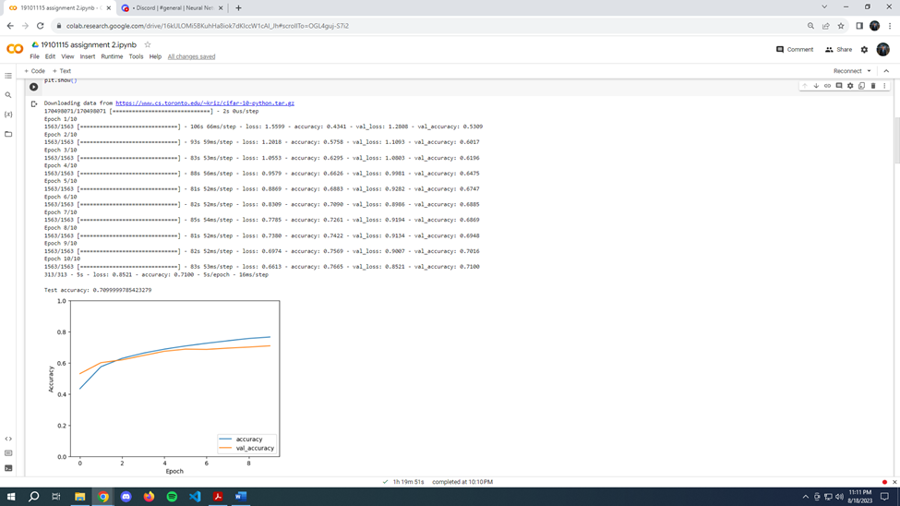
Output

Slide 7
Activation functions
Activation functions used
ReLU
ELU
Sigmoid
Impact of activation functions
Replace activation functions in some convolutional layers

Slide 8
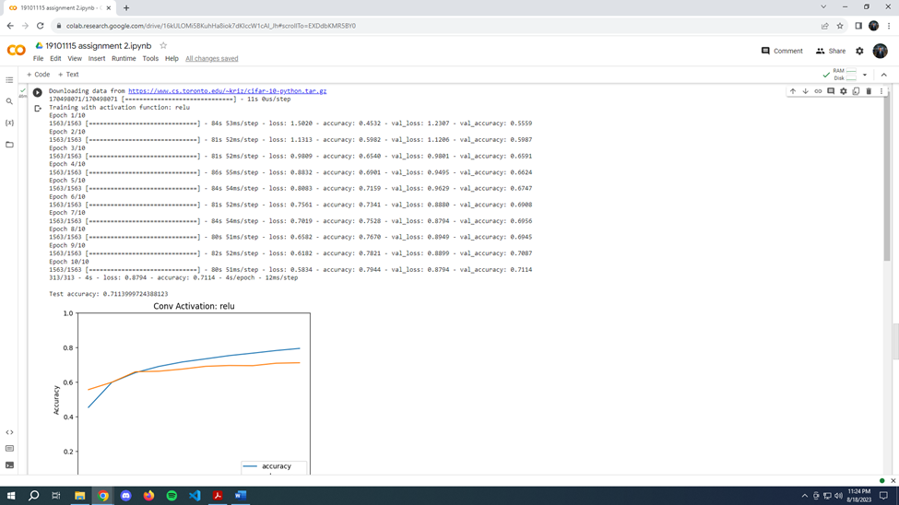
ReLU output

Slide 9
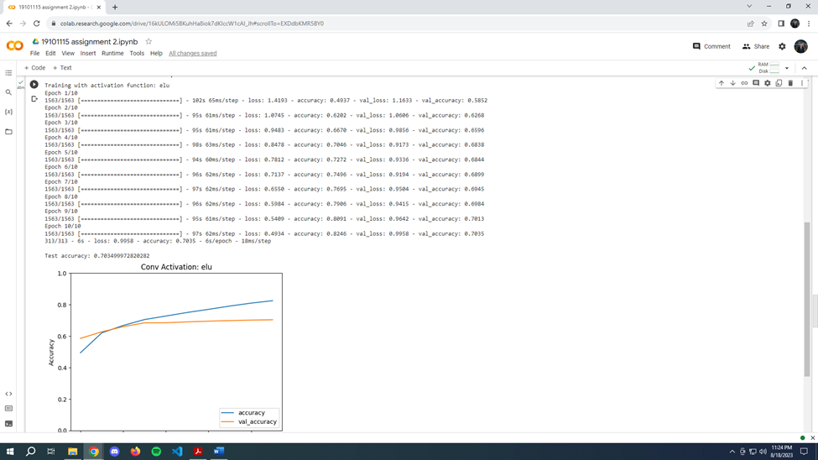
ELU output

Slide 10
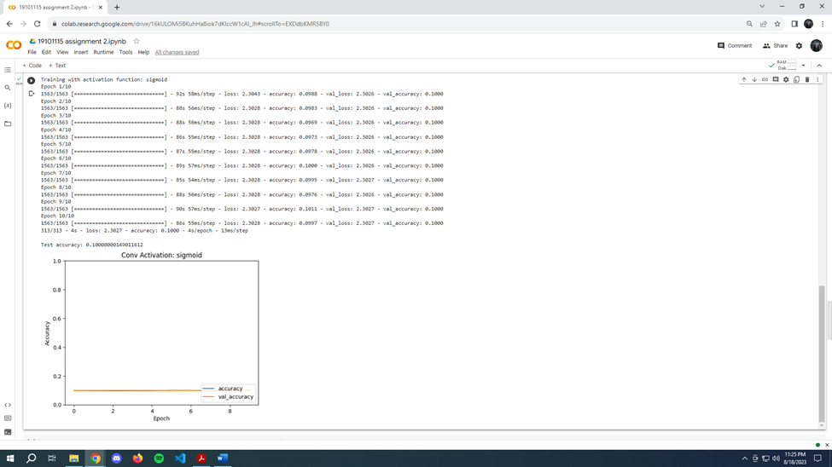
Sigmoid output

Slide 11
Convolutional Layer Configurations
Different types of layer configurations
Effects of layer configurations
Configuration summaries

Slide 12
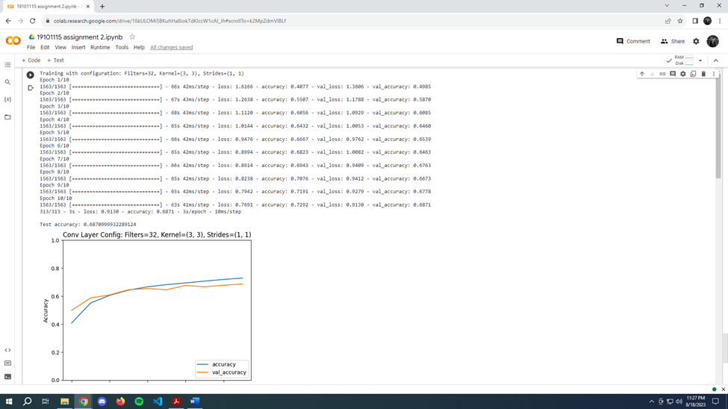
Example of a change in convolutional layer

Slide 13
Comparative Analysis
Model Complexity and Overfitting:
-Traditional CNNs with ReLU activation and moderate filter counts performed well on validation.
-ELU activation slightly improved training accuracy but showed poorer generalization, indicating potential overfitting.
Activation Functions Performance:
-ReLU demonstrated superior accuracy compared to ELU and Sigmoid activations.
- Sigmoid activation struggled with convergence due to vanishing gradients.
Convolutional Layer Configurations Impact:
-Different configurations resulted in varying validation accuracies.
-Smaller filter counts and lower strides favored better generalization.
-Larger strides led to decreased accuracy.

Slide 14
Future works
Advanced Exploration
Hyperparameter tuning
Transfer learning and ensembling

Slide 15
Conclusion
Importance of activation functions and configurations
Keys to enhanced performance
Future implementations

